Slide 1

Balanced News Recommendation Algorithm
Final Report

Slide 2
Problem Statement
Most recommendation algorithms lead to a bias news feed. I sought to design a more balanced recommendation system that would expose users to media they would not typically see at least half the time.

Slide 3
Data Source
MIcrosoft News Dataset – MIND
Contains ~160k English news articles
1 million users
15 million impression logs
Click / No Click (on article)

Slide 4
Data Wrangling
Took a ~350,000 randomized subset of impressions in the original dataset
Columns:
User ID,
Article ID
Interaction
All null values were dropped*

Slide 5
Exploratory Data Analysis
Three Pieces of Information:
Class Distribution
Interaction frequency distribution
Article popularity distribution

Slide 6
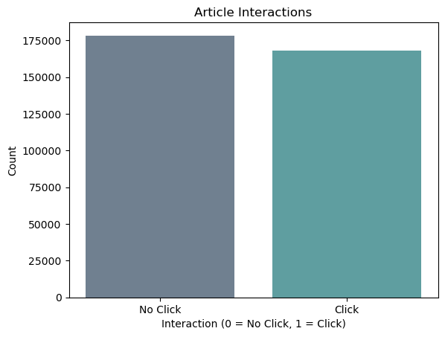

Slide 7
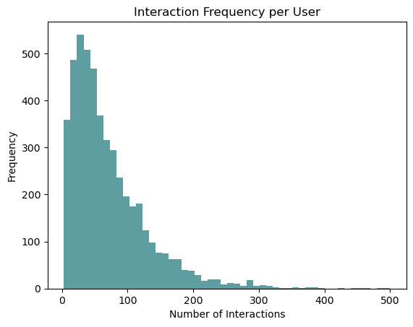

Slide 8
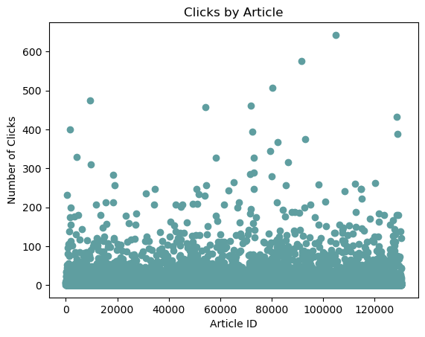

Slide 9
Model Building
Logistic Regression Model
XGBoost
Random Forest Classifier

Slide 10
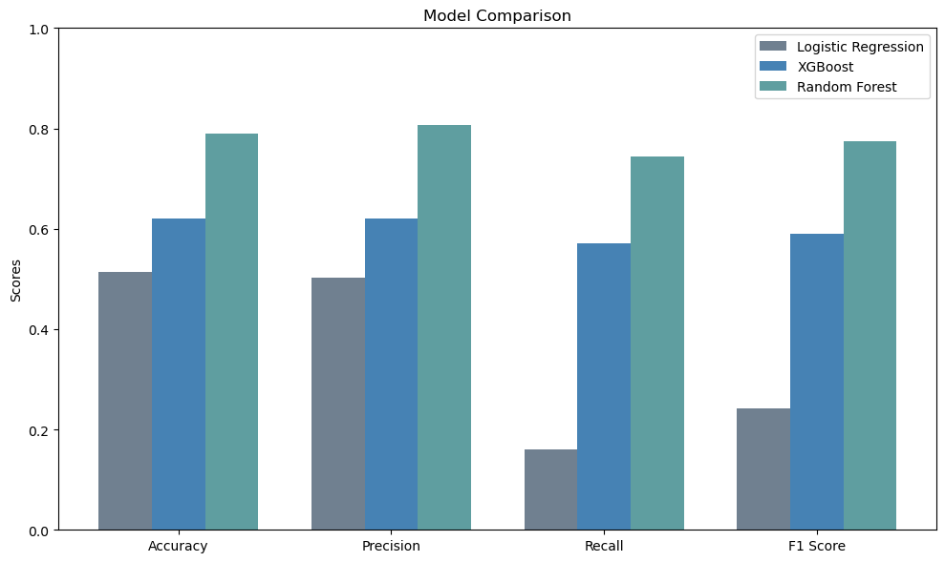

Slide 11
Application & Future Work
Apply balanced recommendation algorithms to:
Google News
Apple News
Microsoft News
Future recommendation algorithms:
Experiment with various predicted interaction cutoffs vs user engagement

